Slide 1


ANALYTIC TOOLS AND DECISION MAKING OLIST INSIGHTS
Group Members:
Manoj Kumar Ravindranath
Sai Sowmith Komakula
Elda Maria Thomas
Jerin Thomas
Srilekhya Byreddi
Siva Krishna Unnam

Slide 2
ABOUT THE COMPANY
Olist is a Brazilian Startup that operates in the e-commerce segment.
It connects small businesses to larger product marketplaces sell their products to a larger customer base.
The company is headquartered in Curitiba, Parana, and has an office in Sao Paulo
The business has 300 employees and more than 9,000 shopkeepers, in addition to 2 million unique consumers.
Merchants sell their products through the Olist Store and ship them directly to the customers using Olist logistics partners.
After a customer purchases the product from Olist Store a seller gets notified to fulfill that order and deliver it to customer.

Slide 3
DATASET DESCRIPTION
Link to dataset https://www.kaggle.com/olistbr/brazilian-ecommerce?select=olist_customers_dataset.csv
This dataset has 9 csv files:
olist_customers_dataset.csv
olist_geolocation_dataset.csv
Olist_order_items_dataset.csv
Olist_order_payments_dataset.csv
Olist_order_reviews_dataset.csv
Olist_orders_dataset.csv
Olist_products_dataset.csv
Olist_seller_dataset.csv
product_category_name_translation.csv
The Olist store dataset has nearly 100000 records of customers orders from 2016 to 2018 from multiple marketplace sellers.

Slide 4
PROBLEM STATEMENT
PROBLEM IN THIS DATASET:
The Dataset contains the order and customer information of nearly 98000 orders and reviews of those orders
Out of these orders, around 22000 orders have least review scores of 1 and 2 and this will be the problem to be solved.
22000 is more than 20% of the orders received in the given time period and this could have a toll on the reputation this E-commerce business
WHY IS IT IMPORTTANT TO SOLVE:
In the contemporary world number of customers for any business is proportional to the number of good reviews provided.
APPROACH:
Descriptive analysis will be used.
Correlation will be found between the Review scores and other variables.
Trends will be analyzed to examine customer behaviour.
Focus will be on target variable which is Review score.

Slide 5
PROPOSAL
Finding the relationships among the files will be the first step towards this project.
Each and every file will be investigated.
All the missing values, outliers and any other discrepancy will be addressed.
Merging tables will be performed based on the needs.
Excel and Python will be used for plotting the graphs.
Tableau will be used to create dashboards and relationships.

Slide 6
FINDINGS FROM EDA
There are 99441 unique customer ids.
There are 27 states and most common state is Sao Paulo.
There are 3095 unique sellers and most of them are from Sau Paulo.
The dataset has less than 5% of the missing values of entire data where we can clearly ignore those values as it won’t affect the dataset.
Most common method used by the customers for payment is through credit card.
Most orders for the olist store comes from the state of Sao Paulo.
Almost 57% of customers form the olist have given 5 as their review score.
Most of the customers choose to pay their payments for products in 0-3 installments by credit card.
Health_beauty and watches_gifts are two product categories which generates most of the revenue for Olist store.
Most of the customers given review score are the people who order value is less than 3000. Anything above 3000 maybe considered as outliers.

Slide 7
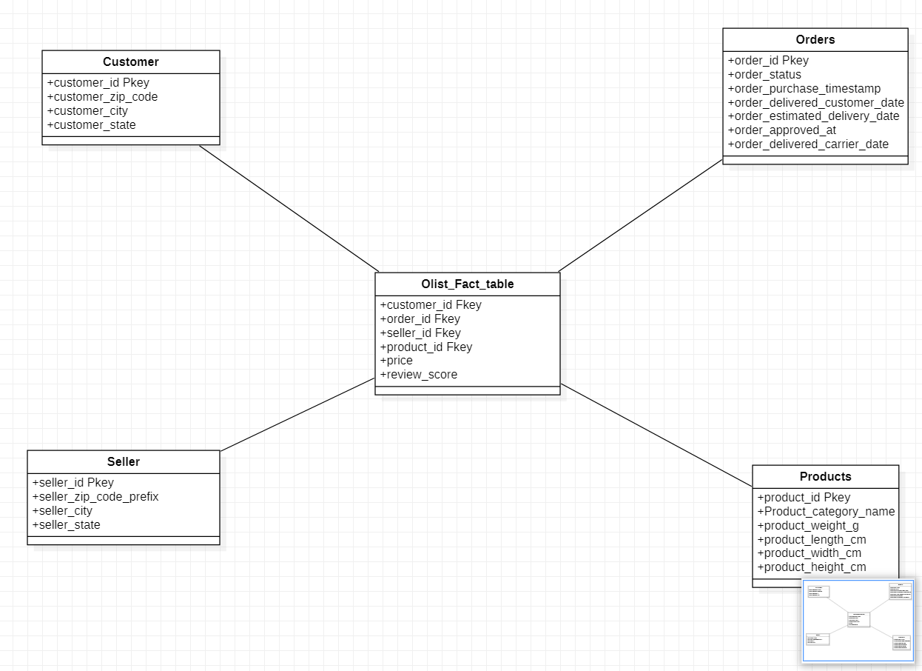
STAR SCHEMA

Slide 8
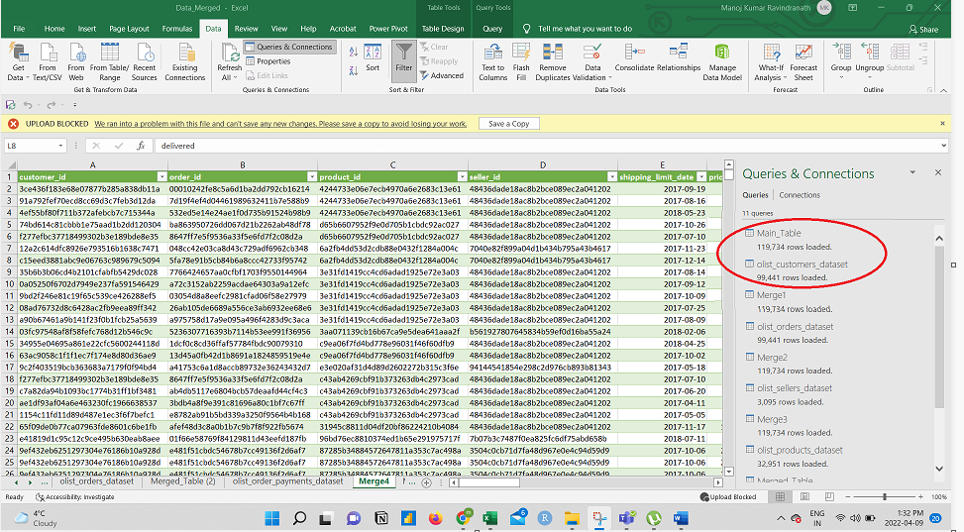
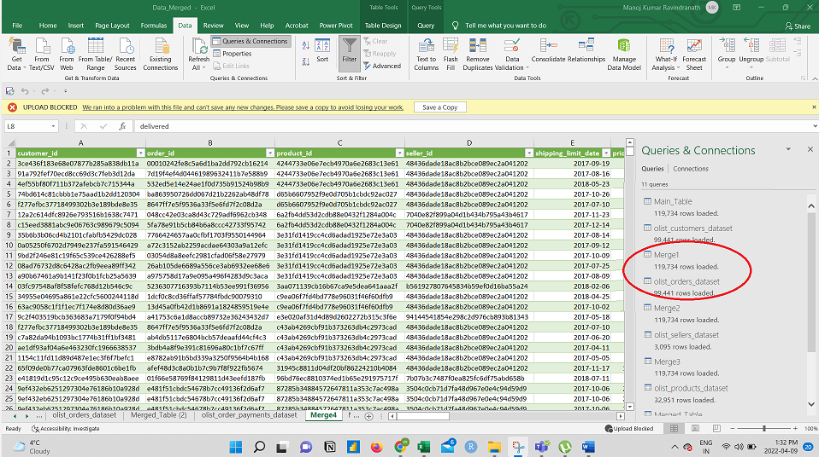
DATA TRANSFORMATION
Merging Tables: Data Merging was performed in Excel; Fact table was taken as a primary table to initiate merging. Second table is olist_customers_dataset.csv
STEP 1: Merging of the Fact table and the customer table was performed based on “customer id” column.
Step 2: The newly merged table is having the fact table information along with the customer details.
This table is now merged with the Olist_orders_dataset.csv based on order id column.
Step 3: Naming the newly merged table as Merge2. This table is further merged with Olist_seller_dataset.csv based on “Seller id” Column.

Slide 9
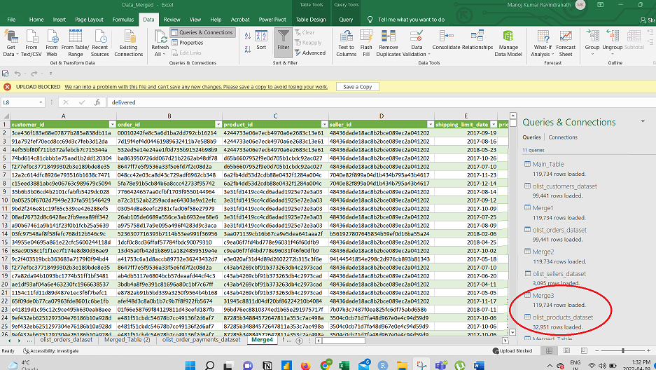
DATA TRANSFORMATION
Step 4: The new table “Merge 3” is merged with Olist_products_dataset.csv based on the “product id“ column.
Step 5: Finally, to get the product name translation from the product_category_name_translation.csv the final table is merged based on product name column.
Now the Merged tables has all the columns from the fact table and the other tables.

Slide 10
DATA CLEANING USING PYTHON
Step 1: Loading necessary packages
Step 2: Importing the csv file
Step 3: Checking the null values
Step 4: Checking duplicate observation
Step 5: Dropping columns
product_length_cm', 'product_height_cm', 'product_width_cm', product_name_lenght
Step 6: Renaming the columns
Step 7: Creating custom columns
Based on the analysis questions few custom columns like “delivery_delay”, ”Days_to_Deliver”, “delayed” have been created.
Step 8: Outlier Treatment
Step 9: Exporting the into CSV file

Slide 11
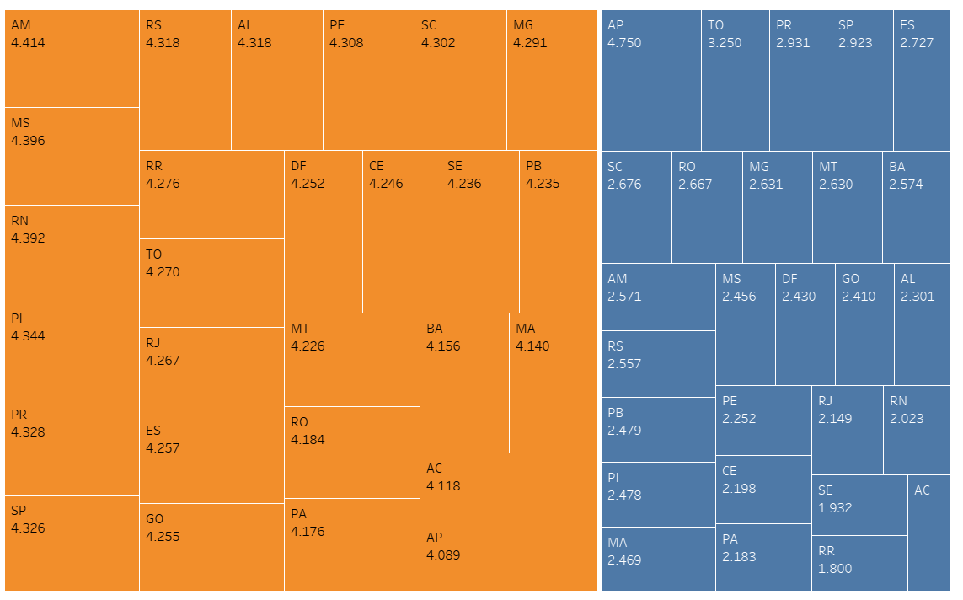
TABLEAU VISUALIZATION
What is the average review score based on delivery delay?
Review score plotted based on whether order was delivered on time or not.
Review score has affect on delivery delays.
Orange portion shows orders delivered on time and has average review score more than 4
Blue portion shows delay in orders that affected review score and has average near to 2.5

Slide 12
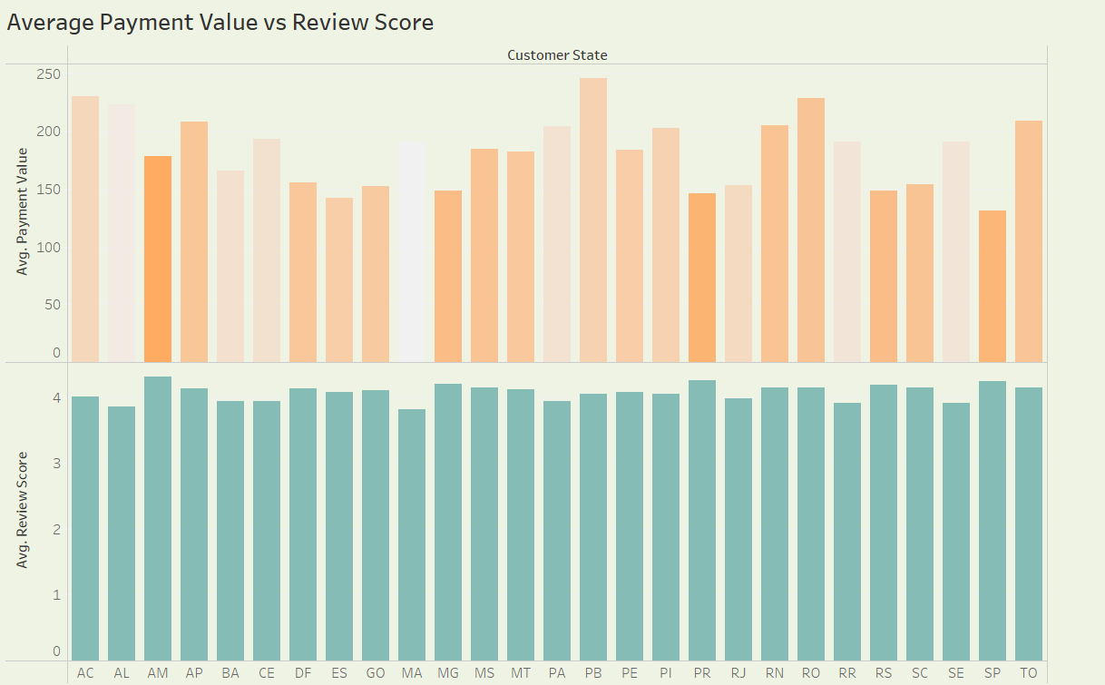
TABLEAU VISUALIZATION
Does the payment value affect the review score?
All provinces have average review score over 4.
States like AL, BA, MA have review score less than 4.
Payment value has no significant effect and no big correlation between these two variables.

Slide 13
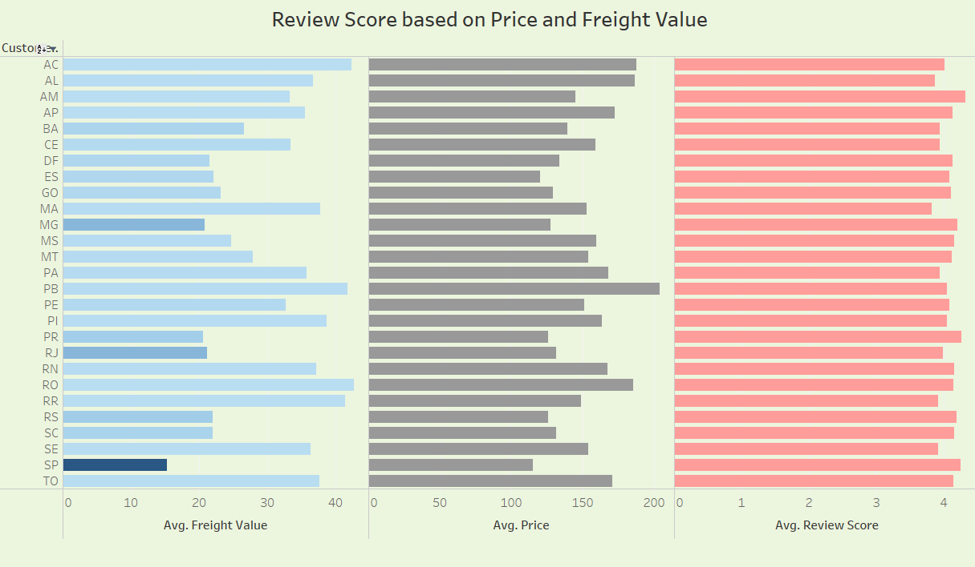
TABLEAU VISUALIZATION
What is the review score based on Price and freight value?
Breaking down payment value into freight value and average price and plotting against review score.
The state with the least freight value has the highest average.
Review score dropped below 4 in the states where freight value is higher.
Price variable have less influence on the review score.

Slide 14
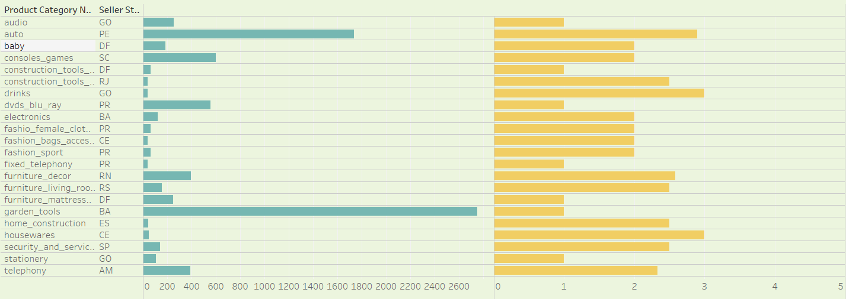
TABLEAU VISUALIZATION
Does the product from a particular seller state affect the review score?
Out of all product category and seller state combination around 20 combinations have review score less than 3.
Products from many states didn’t meet the expectations of the customers.
State PR and GO have been mentioned many times in this graph

Slide 15
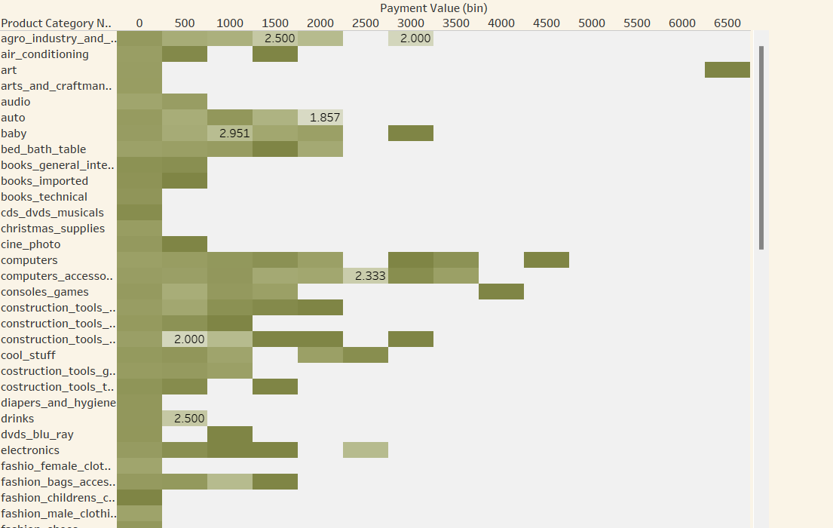
TABLEAU VISUALIZATION
Does the price range of a particular product have an impact on customer behavior?
Review score based on the product category and the amount spend by the customers.
Darker the shade the higher the review
Customers that spent around 1500 and 3000 on Agro industry and commerce product gave low reviews
Computer accessories, Construction tools, and furniture decor got poor reviews.

Slide 16
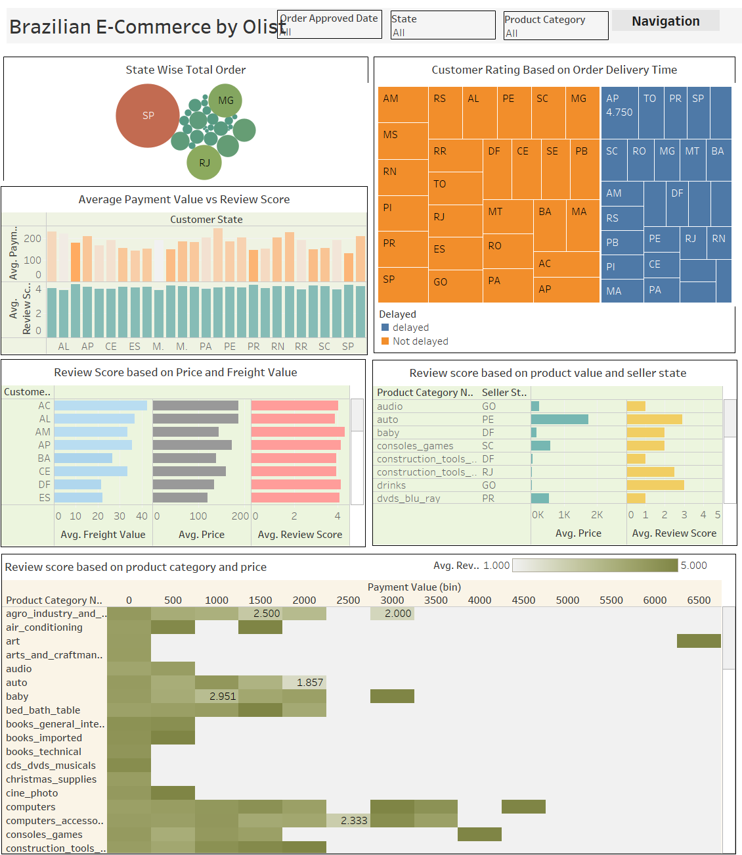
DASHBOARD FROM TABLEAU
Dashboard is created with the visualizations from workbook
Variables such as Order Approved Date, State and Product Category are used for navigation of dashboard.

Slide 17
CONCLUSION
Customers are clearly not happy with the delayed orders, And the orders that were delivered on time is rewarded with high reviews.
Payment value has no direct influence in the review scores
The freight value which is included inside the payment value has an impact on the review scores. If the logistic partner has a way reduce this value, there can be a good change in the customer behavior.
There are states like “GO”, “PR” that are selling products that are disliked by customers, a special attention has to be given to the product from these states.
A product in general has high review scores but drilling down with respect to the prices , products like agro, auto, baby, computer accessories have very poor review score , Hence this must be taken care of.

Slide 18
GITHUB PROJECT REPOSITORY AND TABLEAU PUBLIC DASHBOARD LINK
https://github.com/Hackslash-DA/DB103-Data_Analysis_Project
https://public.tableau.com/app/profile/elda3801/viz/103Final/Dashboard1

